Slide 1
Chapter 1 – Introduction to Computers, the Internet, and the Web
Outline
1.1 Introduction
1.2 What Is a Computer?
1.3 Computer Organization
1.4 Evolution of Operating Systems
1.5 Personal, Distributed and Client/Server Computing
1.6 Machine Languages, Assembly Languages and High-Level Languages
1.7 History of C++
1.8 History of Java
1.9 Java Class Libraries
1.10 Other High-Level Languages
1.11 Structured Programming
1.12 The Internet and the World Wide Web
1.13 Basics of a Typical Java Environment

Slide 2
Chapter 1 – Introduction to Computers, the Internet, and the Web
1.14 General Notes about Java and This Book
1.15 Thinking About Objects: Introduction to Object Technology and the Unified Modeling Language
1.16 Discovering Design Patterns: Introduction
1.17 Tour of the Book
1.18 (Optional) A Tour of the Case Study on Object-Oriented Design with the UML
1.19 (Optional) A Tour of the “Discovering Design Patterns” Sections

Slide 3
1.1 Introduction
Java How to Program, Fourth Edition
  Java 2 Standard Edition
  Object-oriented programming

Slide 4
1.2 What Is a Computer?
Computer
  Performs computations and makes logical decisions
  Millions / billions times faster than human beings
Computer programs
  Sets of instructions for which computer processes data
Hardware
  Physical devices of computer system
Software
  Programs that run on computers

Slide 5
1.3 Computer Organization
Six logical units of computer system
  Input unit
    Mouse, keyboard
  Output unit
    Printer, monitor, audio speakers
  Memory unit
    RAM
  Arithmetic and logic unit (ALU)
    Performs calculations
  Central processing unit (CPU)
    Supervises operation of other devices
  Secondary storage unit
    Hard drives, floppy drives

Slide 6
1.4 Evolution of Operating Systems
Batch processing
  One job (task) at a time
  Operating systems developed
    Programs to make computers more convenient to use
    Switch jobs easier
Multiprogramming
  “Simultaneous” jobs
  Timesharing operating systems

Slide 7
1.5 Personal, Distributed and Client/Server Computing
Personal computing
  Computers for personal use
Distributed computing
  Computing performed among several computers
Client/server computing
  Servers offer common store of programs and data
  Clients access programs and data from server

Slide 8
1.6 Machine Languages, Assembly Languages and High-Level Languages
Machine language
  “Natural language” of computer component
  Machine dependent
Assembly language
  English-like abbreviations represent computer operations
  Translator programs convert to machine language
High-level language
  Allows for writing more “English-like” instructions
    Contains commonly used mathematical operations
  Compiler convert to machine language
Interpreter
  Execute high-level language programs without compilation

Slide 9
1.7 History of C++
C++
  Evolved from C
    Evolved from BCPL and B
  Provides object-oriented programming capabilities
Objects
  Reusable software components that model real-world items

Slide 10
1.8 History of Java
Java
  Originally for intelligent consumer-electronic devices
  Then used for creating Web pages with dynamic content
  Now also used for:
    Develop large-scale enterprise applications
    Enhance WWW server functionality
    Provide applications for consumer devices (cell phones, etc.)

Slide 11
1.9 Java Class Libraries
Classes
  Contain methods that perform tasks
    Return information after task completion
  Used to build Java programs
Java contains class libraries
  Known as Java APIs (Application Programming Interfaces)

Slide 12
1.10 Other High-Level Languages
Fortran
  FORmula TRANslator
COBOL
  COmmon Business Oriented Language
Pascal
Basic

Slide 13
1.11 Structured Programming
Structured Programming
  Structured programs
    Clearer than unstructured programs
    Easier to test, debug and modify
  Pascal designed for teaching structured programming
  ADA
    Multitasking
  C

Slide 14
1.12 The Internet and the World Wide Web
Internet
  Developed over three decades ago with DOD funding
  Originally for connecting few main computer systems
  Now accessible by hundreds of millions of computers
World Wide Web (WWW)
  Allows for locating/viewing multimedia-based documents

Slide 15
1.13 Basics of a Typical Java Environment
Java systems contain
  Environment
  Language
  APIs
  Class libraries

Slide 16
1.13 Basics of a Typical Java Environment (cont.)
Java programs normally undergo five phases
  Edit
    Programmer writes program (and stores program on disk)
  Compile
    Compiler creates bytecodes from program
  Load
    Class loader stores bytecodes in memory
  Verify
    Verifier ensures bytecodes do not violate security requirements
  Execute
    Interpreter translates bytecodes into machine language

Slide 17
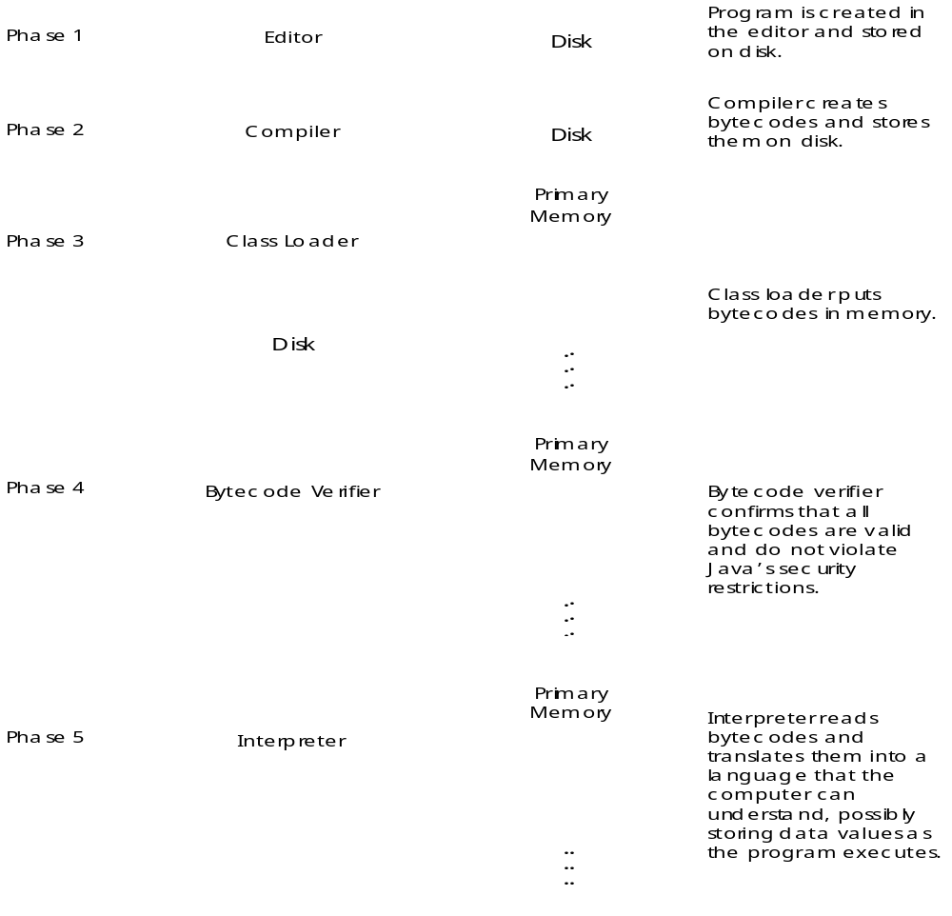
Fig. 1.1 A typical Java environment.

Slide 18
1.14 General Notes about Java and This Book
Geared for novice programmers
We stress clarity

Slide 19
1.15 Thinking About Objects: Introduction to Object Technology and the Unified Modeling Language
Object orientation
Unified Modeling Language (UML)
  Graphical language that uses common notation
  Allows developers to represent object-oriented designs

Slide 20
1.15 Thinking About Objects (cont.)
Objects
  Reusable software components that model real-world items
  Look all around you
    People, animals, plants, cars, etc.
  Attributes
    Size, shape, color, weight, etc.
  Behaviors
    Babies cry, crawl, sleep, etc.

Slide 21
1.15 Thinking About Objects (cont.)
Object-oriented design (OOD)
  Models real-world objects
  Models communication among objects
  Encapsulates data (attributes) and functions (behaviors)
    Information hiding
    Communication through well-defined interfaces
Object-oriented language
  Programming is called object-oriented programming (OOP)
  Java

Slide 22
1.15 Thinking About Objects (cont.)
Object-Oriented Analysis and Design (OOAD)
  Essential for large programs
  Analyze program requirements, then develop solution
  We begin OOAD in Chapter 2
    Elevator-simulation case study

Slide 23
1.15 Thinking About Objects (cont.)
History of the UML
  Need developed for process with which to approach OOAD
  Brainchild of Booch, Rumbaugh and Jacobson
  Object Management Group (OMG) supervised
  Version 1.4 is current version
    Version 2.0 scheduled tentatively for release in 2002

Slide 24
1.15 Thinking About Objects (cont.)
UML
  Graphical representation scheme
  Enables developers to model object-oriented systems
  Flexible and extendible

Slide 25
1.16 Discovering Design Patterns: Introduction
Effective design crucial for large programs
Design patterns
  Proven architectures for developing object-oriented software
    Architectures created from accumulated industry experience
  Reduce design-process complexity
  Promotes design reuse in future systems
  Helps identify common design mistakes and pitfalls
  Helps design independently of implementation language
  Establishes common design “vocabulary”
  Shortens design phase in software-development process

Slide 26
1.16 Discovering Design Patterns (cont.)
Design patterns
  Similar to architectural elements
    arches and columns
  Used by developers to construct sets of classes and objects
Developers
  Familiarity with patterns to understand how to use patterns

Slide 27
1.16 Discovering Design Patterns (cont.)
History of Design Patterns
  Gamma, Helm, Johnson and Vlissides
    “Gang of Four”
    Design Patterns, Elements of Reusable Object-Oriented Software (Addison Wesley: 1995)
    Established 23 design patterns
      Creational
        Instantiate objects
      Structural
        Organize classes and objects
      Behavioral
        Assign responsibilities to objects

